Slide 1
Hexadecimal (base 16)
By mat d

Slide 2
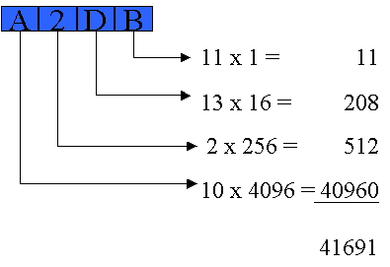
What is hexadecimal
Hexadecimal is a number system like binary or denary that has 16 characters, the numbers 0-9 and then the letters a-f (you can think of these as 10-15)

Slide 3
Why is it used?
Hex is used by programmers to represent numbers stored in a computer, for example rather than having to remember what 1111110110100101 is the programmer could just use FDA5 to represent the same number.
Computers do NOT understand hexadecimal, only binary
*easy conversion method*
To convert from base 10 to base 16 we divide the number by 16, note the remainder and then repeat with the answer until you get zero, then if any remainder is 10 or higher convert it to a letter
163/16= 10 remainder 3
10/16 = 0 remainder 10
10 in hex is A so 163 is A3

Slide 4
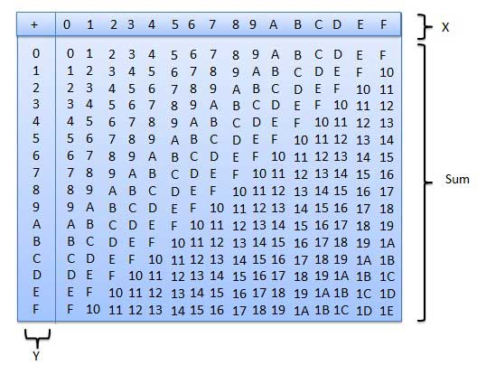
Hexadecimal addition tables
To add together hexadecimal numbers you can use a table like this one, simply find the intersection between the two numbers you want to add
for example
you can add 5 and A to get F

Slide 5
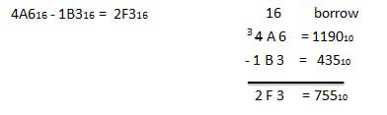
Hexadecimal subtraction
Subtraction in hexadecimal works just like it does in base 10 however you “borrow” a factor of 16 rather than 10

